Slide 1

CNN for Movie Review Sentiment Analysis
Main Topics
Why every company needs NLP
What are the different models available for sentiment analysis
What is Convolutional Neural Network (CNN)
How do CNN’s apply to NLP
Word Embeddings
The Final Model and Results
Improvements

Slide 2
The Power of NLP
NLP is a large field including Machine Translation, Q&A, Sentiment Analysis, Speech Recognition and much more
Value of NLP data held by companies is £1.3T [IDC 2014]
8.4PB of data produced per second [business2community 2016]
Only 10% of organizations commercialise their data [Gartner 2016]
70% of companies have customer feedback data [business2community 2016]
There is an awful lot of text-based data which can be mined or analysed to increase profits
For example Q&A bots with customer database integration means no more call centres or waiting for long periods of time for the customer. Kyle.ai provides Q&A bots to big clients such as Microsoft, Airbnb, LinkedIn, Airlines

Slide 3
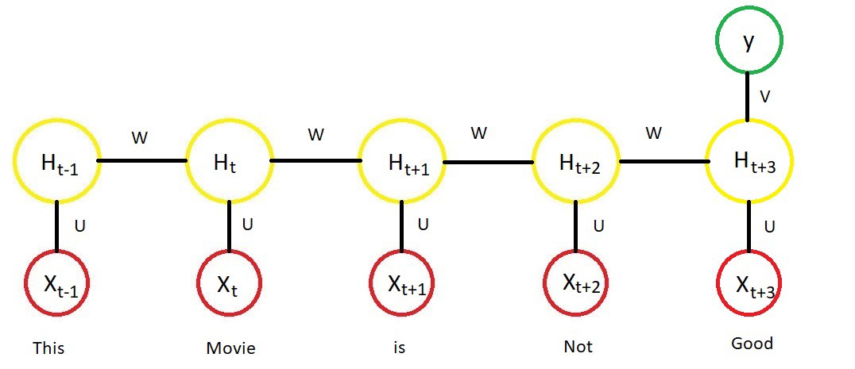
Different Models for Sentiment Analysis
NLP models are not straightforward since machine learning models need vectors of numbers as input not sentences
The words in a sentence can be viewed as sequence data. Can use a Many-to-One LSTM
However for sentiment analysis certain sequences of words give away whether the review is positive or negative regardless of there position
CNN perfect for this as will learn to detect these local sequences of words

Slide 4
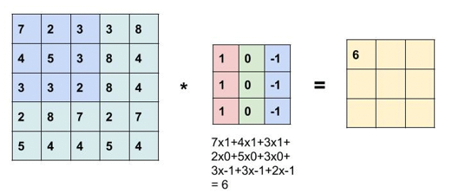
What is a CNN
Takes as input matrices. Most commonly an RGB image which means 1 matrix for each channel of the image
Feature Selector is made up of layers of Convolution followed by Pooling. Convolution is sliding a kernel/filter over the input to create a response map
Common to have multiple filters to produce multiple response maps for each input. For example 64x64x3 RBG image -> 60x60x32 using 32 4x4x3 filters cross-channel sum with no padding

Slide 5
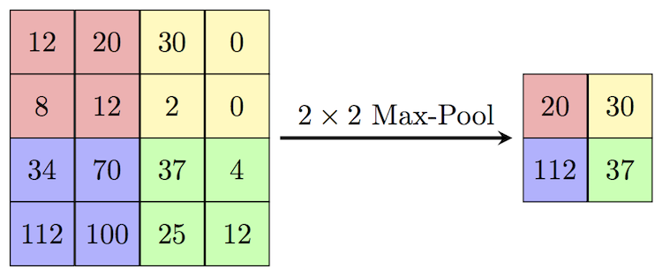
What is a CNN
Max pooling follows Convolution. Takes every response map and reduce it’s dimensionality
Followed by non-linear activation function, ReLU is good
Repeat multiple times for deep CNN
After Feature Selector comes Decision Net
Multi-layer Perceptron with output having only one node in our case
Use SoftMax for multiple output nodes or sigmoid if only one output node

Slide 6
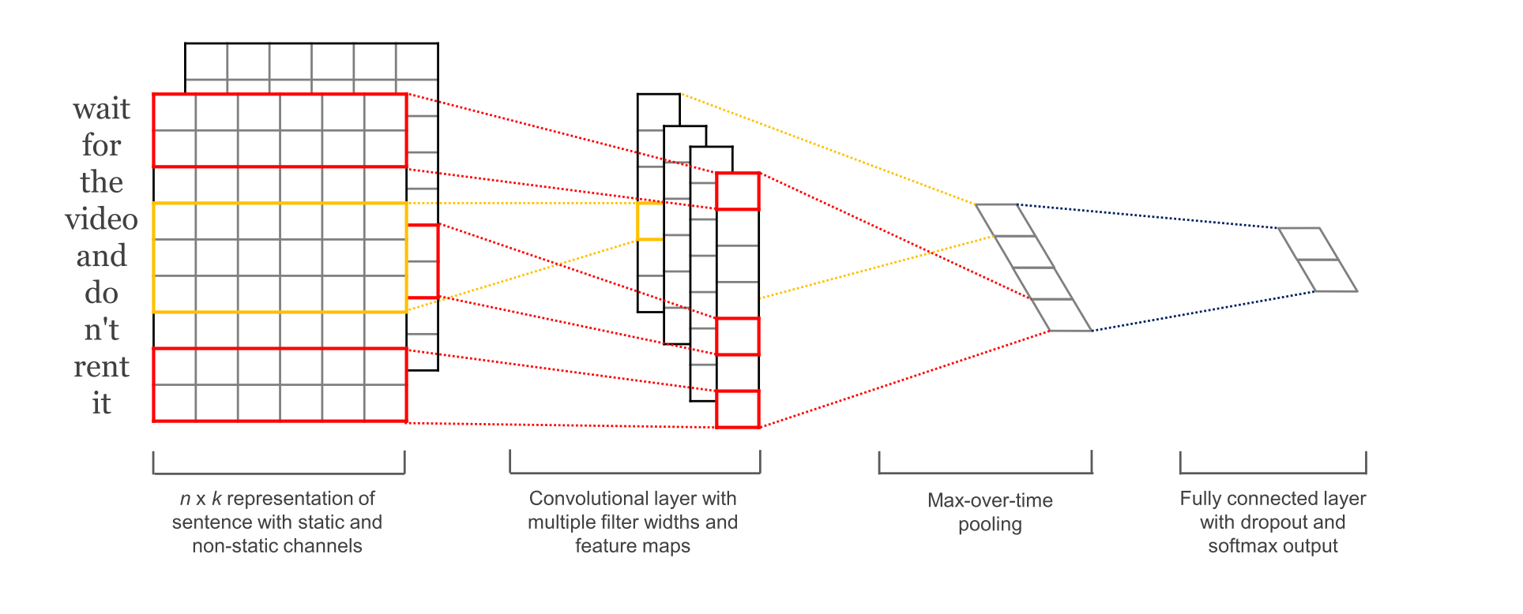
CNN for NLP
Need to convert each movie review to a matrix for our model
Done by word embedding (GloVe or Word2Vec) which is a pre-trained matrix on a large text corpus
Puts each word in a vocabulary into a fixed vector space (e.g. 300 dimensional)
Similar words are placed close to each other in the vector space therefore capturing meaning of words
Almost the same except perform 1D Convolution and MaxPooling instead of 2D

Slide 7
The Final Model
Movie Review Polarity Dataset. 1000 positive reviews, 1000 negative reviews
300D GloVe Word Embedding trained on 6B words
Movie reviews padded to third percentile length, e.g. if third percentile is 700 words, input matrix will have dimensionality 700x300
3 Channels each with their own trainable word embedding seeded with GloVe
Channels each have 32 filters with kernel size 5, 6, 7 respectively
Followed by Dropout with 50% chance, MaxPooling and ReLU
96 Response maps flattened and concatenated to form 20096 -> 10 -> 1 MLP

Slide 8
The Final Model
Binary cross entropy used as cost function and adam optimizer
24,799,877 trainable parameters
Training Accuracy: 100%
Test Set Accuracy: 85%
Trained using Keras, TensorFlow backend
Code available on my github: https://github.com/psyfb2

Slide 9
Improvements
Instead of GloVe or Word2Vec use BERT
Tune hyper-parameters using grid search
K-Fold Cross Validation for more reliable accuracy measurement
Character level Deep CNN has been shown to outperform word level CNN
Next project is a non-goal oriented Q&A chatbot using deep Sequence to Sequence LSTM
Thanks for Listening!

